Slide 1
Robotics Group Project
Jack Galvin - K1502525 (1507192)
Jamie Slome - K1502586 (1515864)
Zehra Punjwani - K1502450 (1431800)

Slide 3
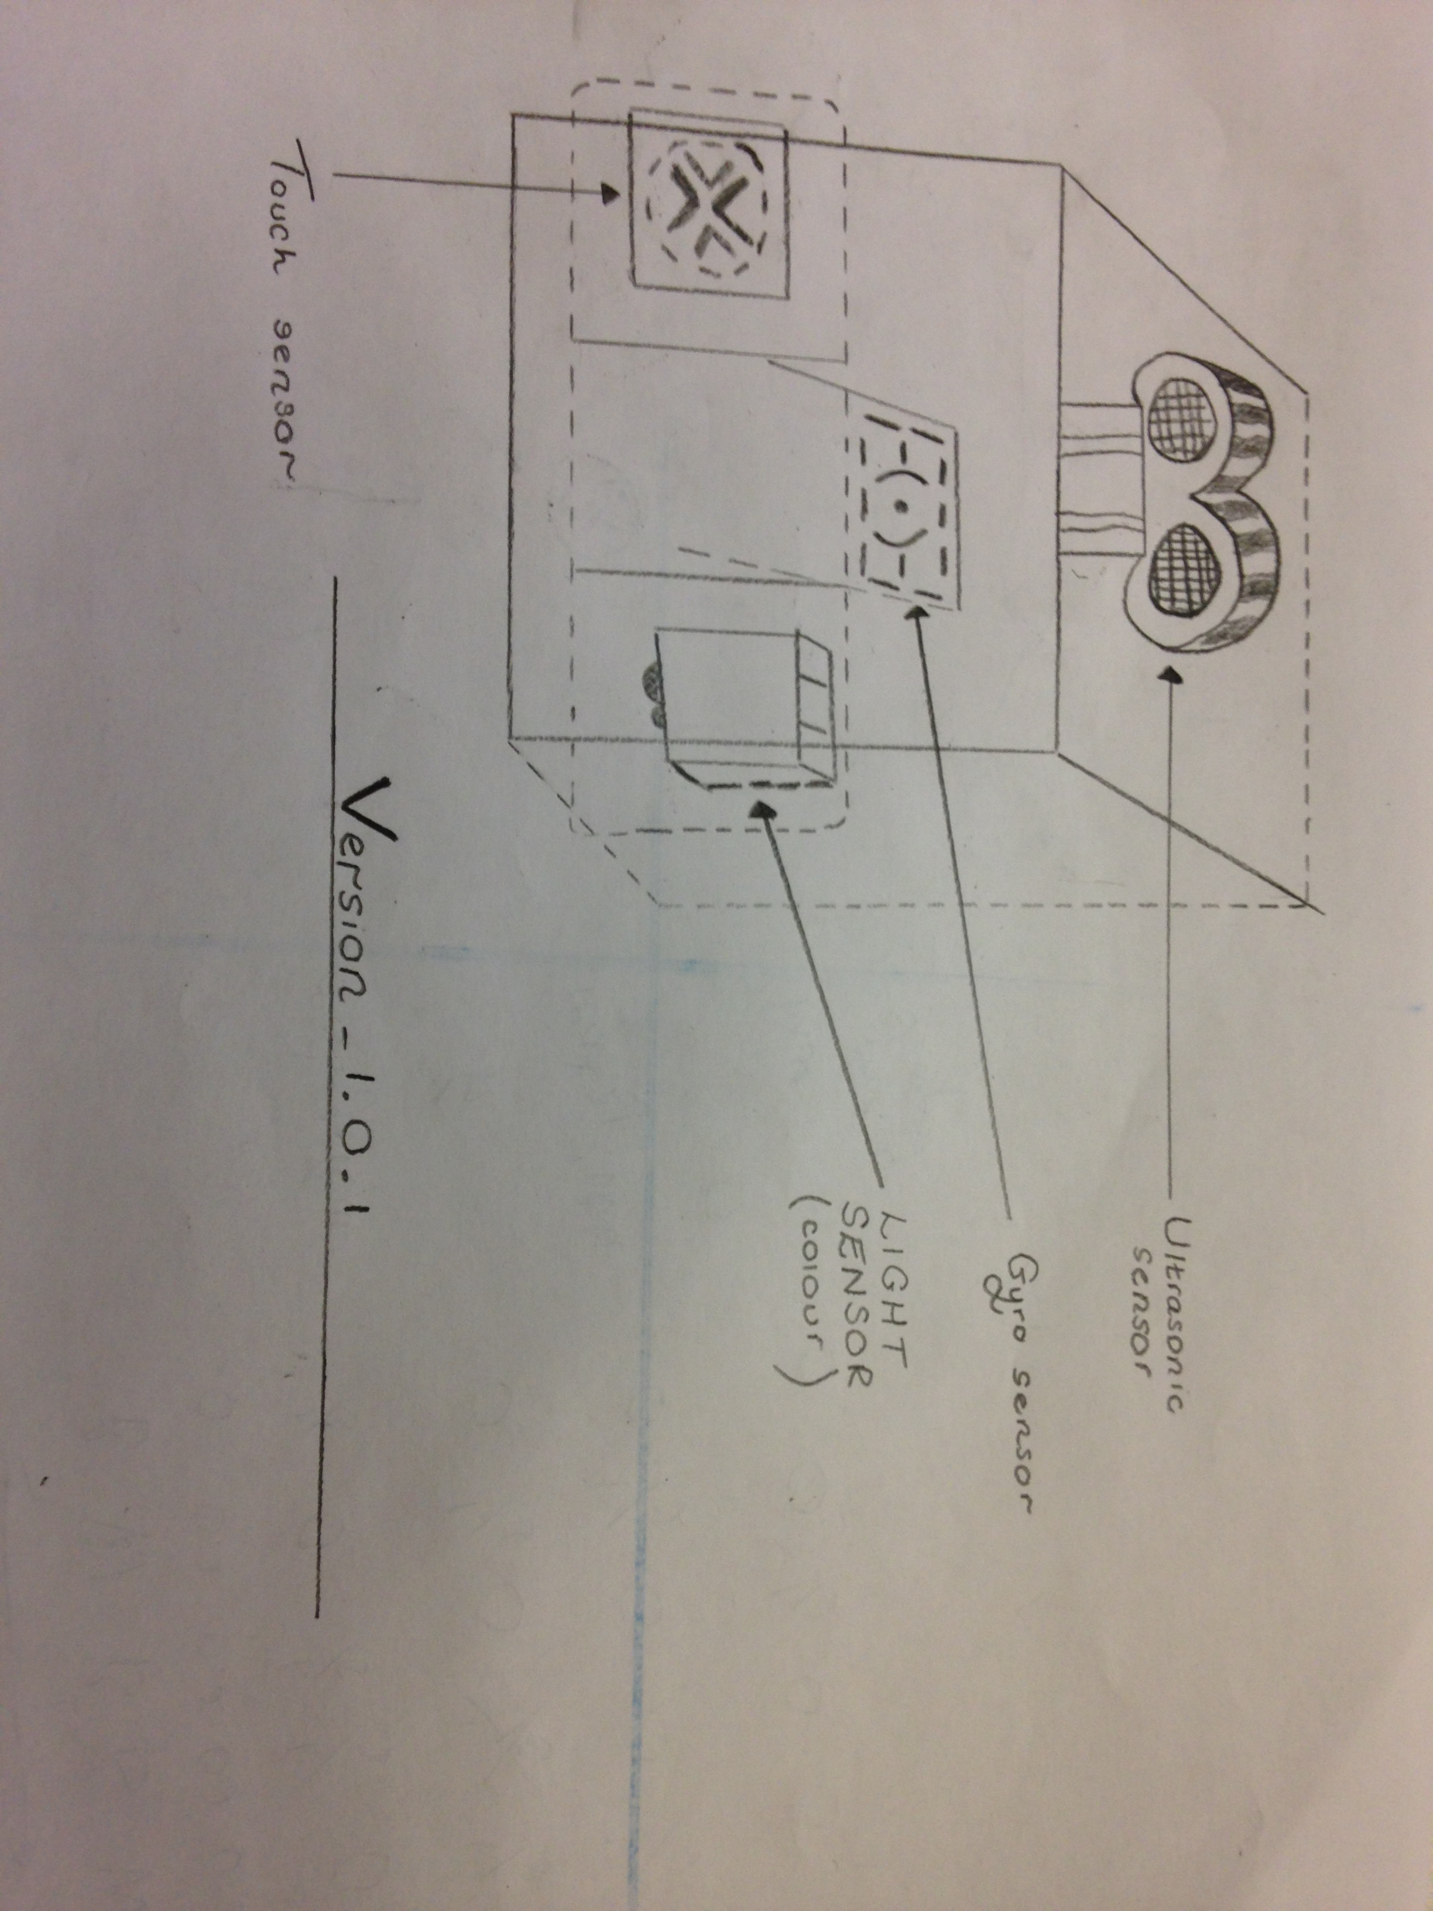
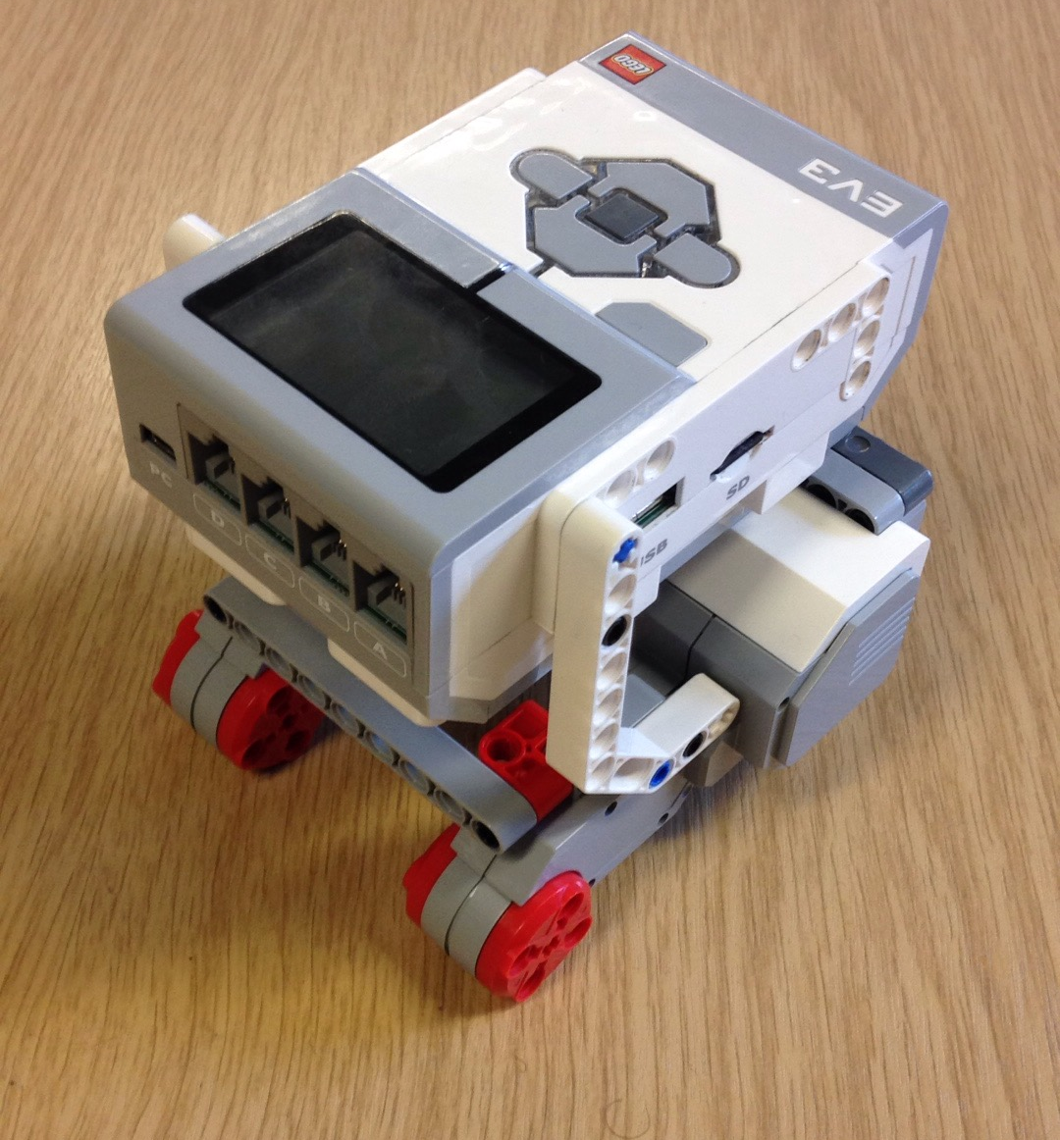
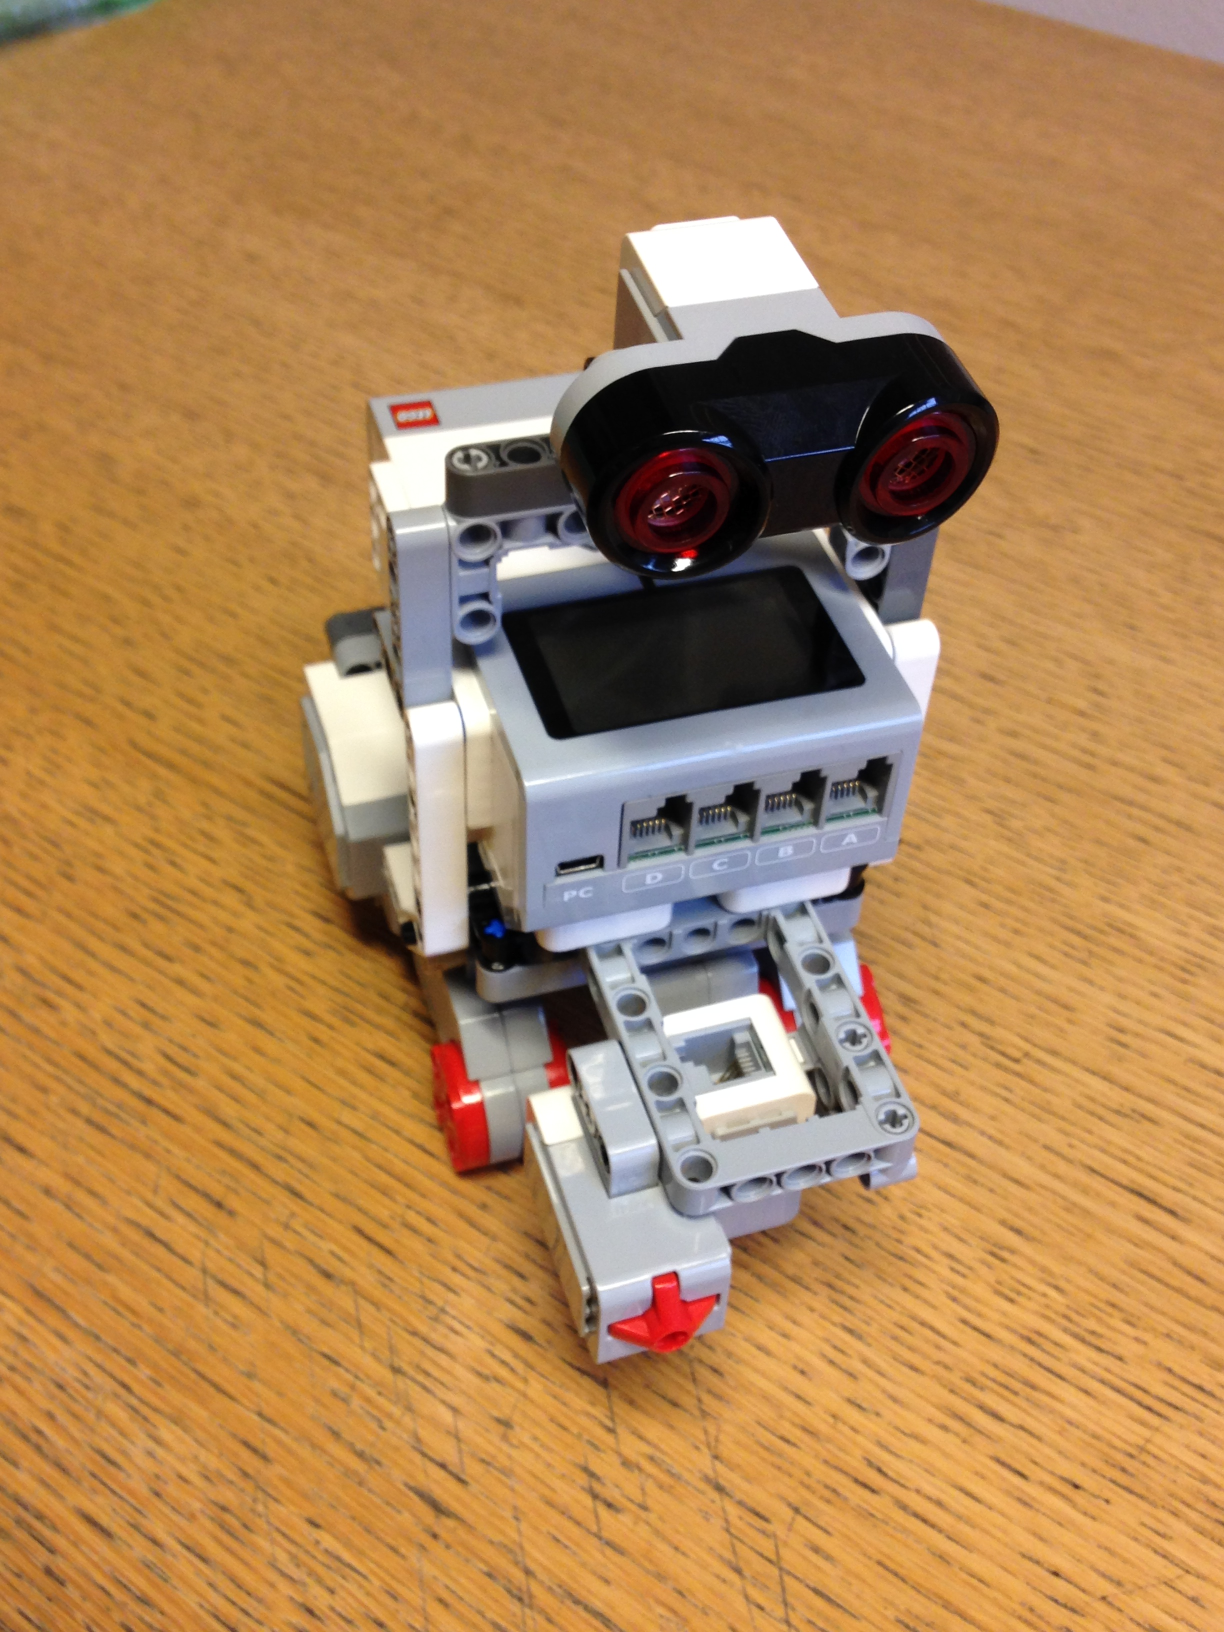
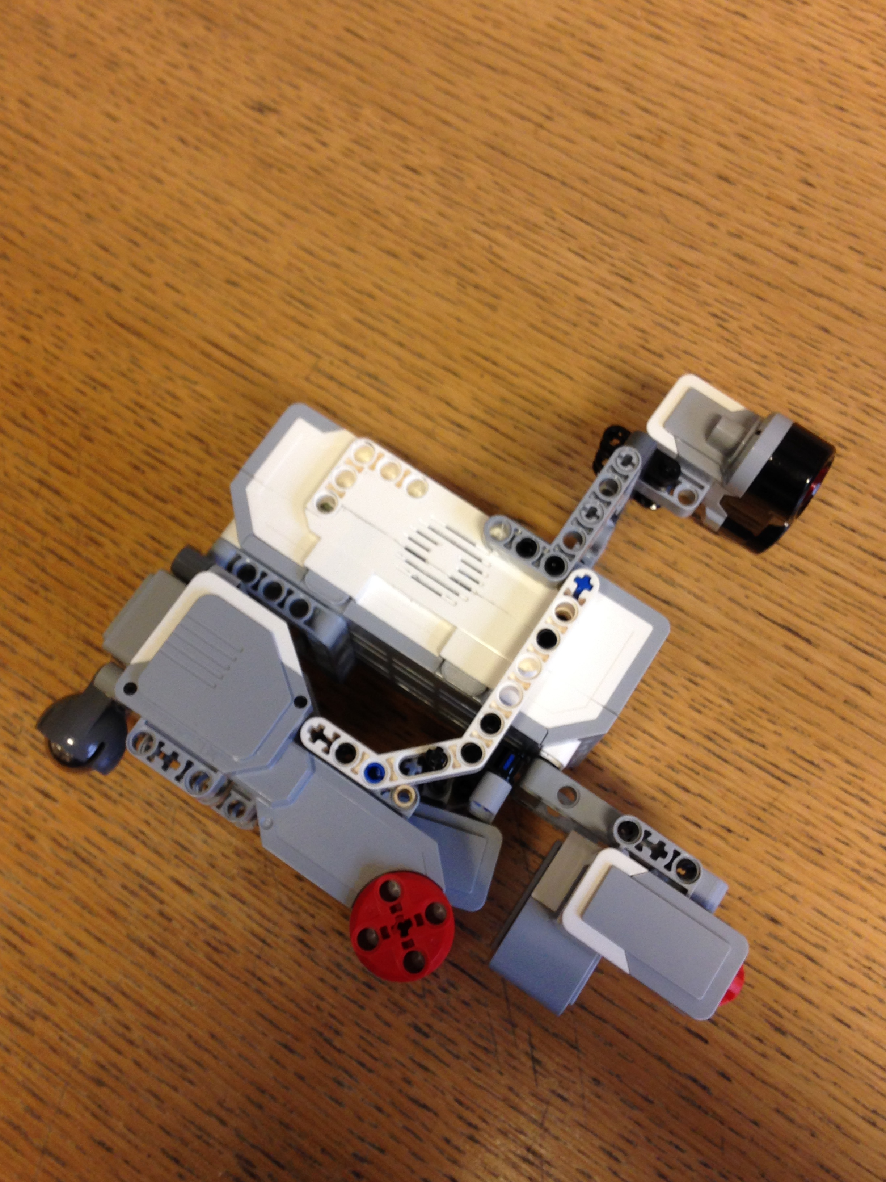
HARDWARE DESIGN

Slide 4
Evaluation Results

Slide 5
EV3LightSensor readings
Test Noº | White tile reading | Blue tile reading
1 | 0.73 | 0.1
2 | 0.60 | 0.14
3 | 0.73 | 0.13
4 | 1.00 | 0.10
5 | 0.80 | 0.12
6 | 0.78 | 0.10
7 | 0.76 | 0.11
8 | 0.80 | 0.11
9 | 0.79 | 0.11
10 | 0.79 | 0.13
11 | 0.81 | 0.11
12 | 0.78 | 0.11
13 | 0.75 | 0.13
14 | 0.79 | 0.09
15 | 0.77 | 0.11
16 | 0.74 | 0.12
17 | 0.74 | 0.10
18 | 0.75 | 0.15
19 | 0.75 | 0.11
20 | 0.79 | 0.13
21 | 0.86 | 0.11
22 | 0.82 | 0.10
23 | 0.81 | 0.10
24 | 0.75 | 0.10
25 | 0.77 | 0.11
26 | 0.80 | 0.13
27 | 0.75 | 0.13
28 | 0.77 | 0.10
29 | 0.87 | 0.10
30 | 0.81 | 0.11
Purpose of the test:
In these series of tests we will be hardcoding raw EV3LightSensor readings so that we can separate colours into discretised TRUE and FALSE values to use in our localiseLine() method.
The test will take a white reading and a blue reading for every test record. From each of the colour readings, at the end of the test we will take an average and use these values inside our code (processLight() method).
The mean value given for black tile reading is: 0.782.

Slide 6
Single Function Testing Results

Slide 7
Integrated System Testing Results

Slide 8
SOFTWARE DESIGN

Slide 9
Implementation Details
Tasks
1: Self-localization – Localizing the robot using the Bayesian localization Filter to obtain the location with respect to a known line using the pattern of the line as an indicator.
2: Path planning – finding the shortest path to the goal and reaching it using A* path finding algorithm.
3: Navigation – The self-localization and A* path finding algorithm data as been brought together to navigate the robot to its goal. The Robot rotates towards the arrow path, reads the Colour of the Colour pad, on arrival a beep-sound is played to indicate arrival and then Manoeuvres out of the obstacle
4: Colour detection & planning – Now that we know the position of the second Colour pad via the first, we can route back to starting position

Slide 10
Evaluation Results

Slide 11
Single Function Testing Results

Slide 12
Integrated System Testing Results

Slide 13
TEAM MANAGEMENT

Slide 14
Project Milestones

Slide 15
Main Tasks, Time Lines and Individual Contribution

Slide 16
CONCLUSION

Slide 17
Comments and Future Improvements

